Slide 1
COMP6599 – Algorithm and Programming
Week 5
Session 6
Pointers and Arrays

Slide 2
Sub Topics
Pointers and Arrays
Pointer
Array
Pointer Constant & Pointer Variable
String
Program Examples

Slide 3
Pointer

Slide 4
Pointer Definition
Pointer is a variable that store the address of another variable
Syntax :
<type> *ptr_name;
Two operators mostly used in pointer : * (content of) and & (address of)
Example:
Initialize an integer pointer into a data variable:
int i, *ptr;
ptr = &i;
To assign a new value to the variable pointed by the pointer:
*ptr = 5; /* means i=5 */

Slide 5
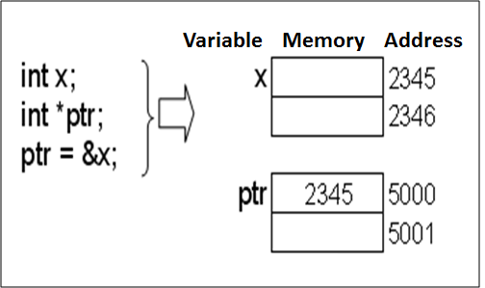
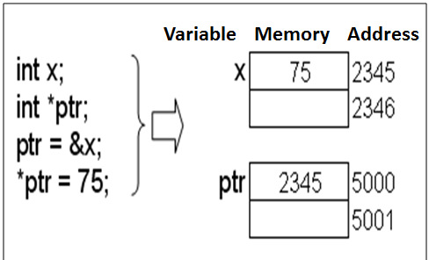
Pointer Concept

Slide 6
Pointer to Pointer
Pointer to pointer is a variable that saves another address of a pointer
Syntax:
<type> **ptr_ptr ;
Example:
int i, *ptr, **ptr_ptr;
ptr = &i;
ptr_ptr = &ptr;
To assign new value to i:
*ptr = 5; // means i=5 ;
**ptr_ptr = 9; // means i=9; or *ptr=9;

Slide 7
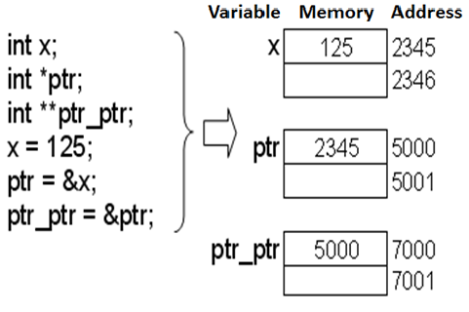
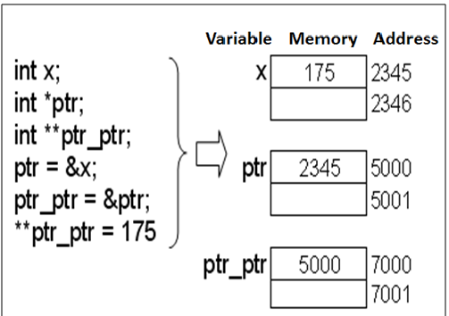
Pointer to Pointer Concept

Slide 8
Array

Slide 9
Array Definition
Data saved in a certain structure to be accessed as a group or individually. Some variables saved using the same name distinguish by their index.
Array characteristics:
Homogenous
All elements have similar data type
Random Access
Each element can be reached individually, does not have to be sequential

Slide 10
Array Definition
Syntax:
type array_value [value_dim];
Example :
int A[10];
The definition consists of 4 components:
Type specified
Identifier (name of the array)
Operator index ([ ])
Dimensional value inside operator [ ]

Slide 11
Array Definition
An illustration of array 1Dimensional
Elements of an array indexed starting from 0
A[0]
A[1]
A[2]
A[3]
A[4]
A[5]
A[6]
A[7]
A[8]
A[9]

Slide 12

Array Initialization
Array can be initialized explicitly without dimensional value declaration
Example:
int B[ ]={1, 2, -4, 8};
Array B has 4 elements
Example:
int B[8]={1, 2, -4, 8};

Slide 13
Array Initialization
Example: int B[4] = { 1, 2, -4, 8, 9 }; //error
error in result; smaller dimensional value
Example array initialization after definition:
int A[5];
(for i=0; i<5;i++) A[i]=0;
int B[5];
B[5]={0,0,0,0,0};
Error, why ?

Slide 14
Accessing Arrays
Two analogous ways of accessing an element i=3;
*(A+3) or A[3]
A is equivalent with &A[0] or a constant pointer to the first element of particular array
To show A[3] on the monitor screen:
printf(“%d”,A[3]) or
printf(“%d\n”,*(A+3));

Slide 15
Accessing Arrays
Accessing array using a pointer
int arr[10];
int *ptr_arr;
ptr_arr = arr; //or ptr_arr = &arr[0];
To access certain element can be done using:
ptr_arr[i];
arr[i];
*(ptr_arr + i);
*(arr + i);
ptr_arr = ptr_arr + i; *ptr_arr;

Slide 16
Assigning Values in Array
Assigning value to an element
Example : A[6] = 15; A[3] = 27;
Statement A[2] = A[3] - A[6], resulting:
27
15
A[0]
A[1]
A[2]
A[3]
A[4]
A[5]
A[6]
A[7]
A[8]
A[9]
12
27
15
A[0]
A[1]
A[2]
A[3]
A[4]
A[5]
A[6]
A[7]
A[8]
A[9]

Slide 17
One Dimensional Array
C compiler does not limit number of dimensional which can be created. Our PC memory does.
Example Array 1D:
#include<stdio.h>
int SIZE = 5;
void main() {
int i, j;
int n[SIZE] = {15, 9, 1, 7, 5};
for( i=0 ; i<= SIZE ; i++) {
printf("%5d ", n[i]);
for ( j=1; j<=n[i] ; j++) printf("%c","*");
printf("\n");
}
}

Slide 18
Two Dimensional Array
Syntax 2D Array:
type name_array[row][col];
Example:
int a[3][4];
Column 0
Column 1
Column 2
Column 3
Row 0
a[ 0 ][ 0 ]
a[ 0 ][ 1 ]
a[ 0 ][ 2 ]
a[ 0 ][ 3 ]
Row 1
a[ 1 ][ 0 ]
a[ 1 ][ 1 ]
a[ 1 ][ 2 ]
a[ 1 ][ 3 ]
Row 2
a[ 2 ][ 0 ]
a[ 2 ][ 1 ]
a[ 2 ][ 2 ]
a[ 2 ][ 3 ]
Column subscript
Array name
Row subscript

Slide 19
Two Dimensional Array
Initialization:
using rmo (row major order)
Example:
int b[2][2] = {1, 2, 3, 4 };
int b[2][2] = { { 1, 2 }, { 3, 4 } };
int b[2][2] = { { 1 }, { 3, 4 } };
int x[3][4] = {1, 2, 3, 4, 5, 6, 7, 8, 9, 10, 11, 12};
int x[3][4] = { {1, 2, 3, 4},
{5, 6, 7, 8},
{9, 10, 11, 12}
};
1 2
3 4
1 0
3 4

Slide 20
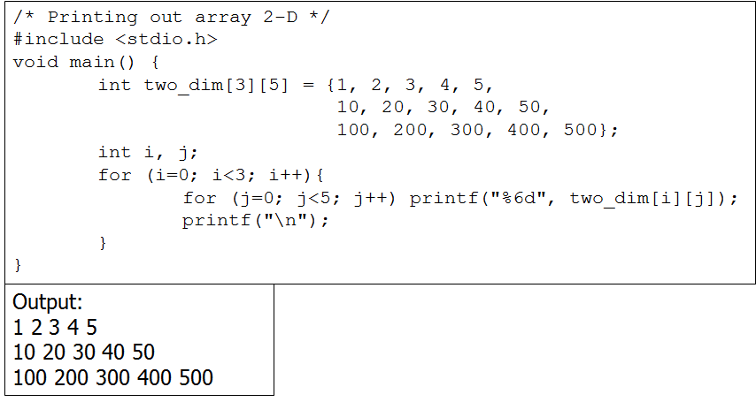
Two Dimensional Array
Example Array 2D:

Slide 21
Three Dimensional Array
Syntax 3D Array :
type name_array[row][col][depth];
Example:
int x[3][2][4] = {{{1,2,3,4}, {5,6,7,8}},
{{11,12,13,14}, {15,16,17,18}},
{{21,22,23,24}, {25,26,27,28}}
};
void main() {
int x[4][3][5] = {{{1, 2, 3}, {0, 4, 3, 4}, {1, 2}},
{{9, 7, 5}, {5, 7, 2}, {9}},
{{3, 3, 5}, {2, 8, 9, 9}, {1, 2, 1}},
{{0}, {1}, {0, 1, 9}}
};
printf(“%5d”, x[2][1][3]);
}

Slide 22
Array of Pointer
An array filled with pointer/s
Syntax :
type *array_name [value_dim];
Example:
int i;
int *ptr[4];
int x=1, y=2, z=3, w=5;
ptr[0]=&x, ptr[1]=&y; ptr[2]=&z; ptr[3]=&w;
for(i=0;i<4;i++) printf("%d ",*ptr[i]);
Output : 1 2 3 5

Slide 23
Array of Character
Array filled with character/s
Syntax:
char array_name[value_dim];
Example:
char name[40];
char ss[20]={‘B’,’I’,’N’,’U’,’S’}; //20 elements
char ss[ ]= {‘B’,’I’,’N’,’U’,’S’}; // 5 elements

Slide 24
Pointer Constant & Pointer Variable

Slide 25
Pointer Constant & Pointer Variable
Pointer variable is a pointer that can be assigned with new value at run-time.
Pointer constant is a pointer that can not be assigned with new value at run-time
Array is Pointer Constant to its first element of the array. Array can be filled with pointer variable.
Example:
int x=10, y=20;
int *ptr; //ptr is pointer variable
ptr = &x;
ptr = &y;

Slide 26
Pointer Constant & Pointer Variable Example 1
Example:
int x=10, y=20;
int B[4]; // B is an Array → pointer constant
int *ptr; // ptr is a pointer variable
ptr = &x; // ok
ptr = B; // ok
ptr++; // ok
B = ptr; // error
B++; // error
B = &y; // error
ptr = B; analogous with ptr = &B[0]; B is a pointer constant pointing to the first element of an array.

Slide 27
Pointer Constant & Pointer Variable Example 2
Pointer constant can only be initialized at definition time
Example:
int Arr1[10];
Arr1[10] = {1, 2, 3, 4, 5}; // error
Arr1 = {1, 2, 3, 4, 5}; // error
Arr1[10] = 12; // error max 9
Arr1[0] = 23; // ok
int Arr2[10] = {1, 2, 3, 4, 5}; //ok

Slide 28
String

Slide 29
String
String is an array of character that ended with null character ( ‘\0’ or in ASCII = 0)
String constant or string literal is some characters written between double quote
Example: ”Welcome to Binus”
String constant type is pointer constant, thus can be assigned to an array of character :
Example :
char name[40] = ”Amir”; //ok
name = ”Amir”; // error name is a constant pointer
Name[40]= “Amir”; //error

Slide 30
String
A Constant String can be linked at compile-time:
”Hello,” ” world”
Similar to:
”Hello, world”
Example string initialization:
char s[ ] = ”BiNus”;
Similar to :
char s[ ] = {’B’,’i’,’N’,’u’,’s’,’\0’};
String as a data type does not known in C

Slide 31

Char vs String
Character in c written between single quote. Each uses one byte of computer memory
Example:
char ch=’A’;
char ch=65; //Ascii
char ch=0x41; //Ascii
String written in between double quote.
Similar

Slide 32
String Manipulation
In Standard Library Function (header file string.h) provides functions to manipulate string:
strlen()
Return a value of string length; excluded null char
strcpy(s1,s2)
Copy s2 to s1
strncpy(s1,s2,n)
Copy first n characters of s2 to s1
strcat(s1,s2)
Adding string s2 to the end of string s1
strncat(s1,s2,n)
Adding n characters of string s2 to the end of string s1
strcmp(s1,s2)
Comparing the value of string s1 and s2, if similar returning 0
etc.

Slide 33
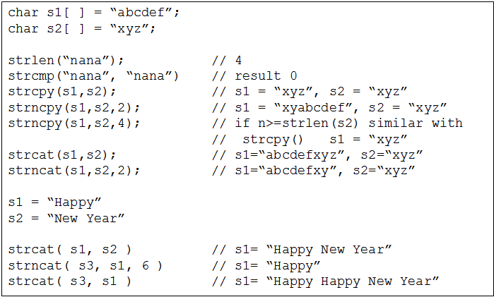
Program Example : String Manipulation 1
Example: (String Manipulation)

Slide 34
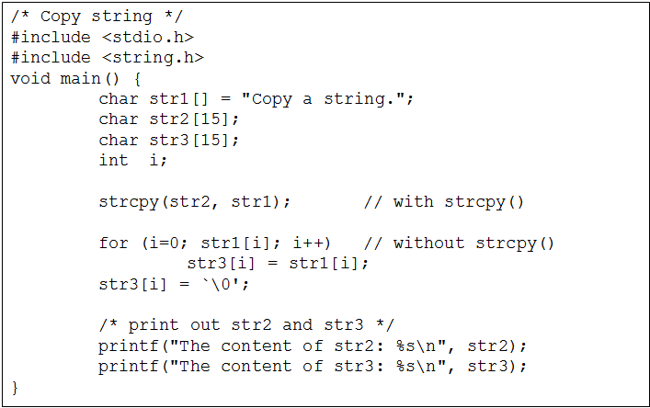
Program Example : String Manipulation 2
Example: (Copy String)

Slide 35
Summary

Slide 36
Summary
Pointer is a variable that store the address of another variable
Pointer to pointer is a variable that saves another address of a pointer
Data saved in a certain structure to be accessed as a group or individually. Some variables saved using the same name distinguish by their index which called as an array
String is an array of character that ended with null character

Slide 37
References
Paul J. Dietel,Harvey M. Deitel,. 2010. C : how to program. PEAPH. New Jersey. ISBN:978-0-13-705966-9 Chapter 6 & 7
C Programming – Pointers: http://www.exforsys.com/tutorials/c-language/c-pointers.html
Storing Similar Data Items: http://aelinik.free.fr/c/ch12.htm

